Slide 1


Building a COM Object using ATL
COM Programming
Notes:
Page <number>
WNCOMPG-2 v1.5
Chapter 6, Building a COM Object using ATL

Slide 2


Chapter Overview
Objectives
  Build a simple COM object using ATL
Chapter content
  Using the ATL COM App and ATL Object Wizards
  Review of generated files
  Registry script
  Adding methods and properties
  Adding a new custom interface
  Class relationships
Practical content
  Using ATL to write a COM object
Summary
Notes:
Page <number>
WNCOMPG-2 v1.5
Chapter 6, Building a COM Object using ATL

Slide 3


What is ATL?
A collection of C++ template classes, macros and wizards that make it easier to develop COM components
  Optimised for building small, fast non-visual components
  No run-time library necessary
  Automatic generation of "boilerplate" code required to implement class factories, object creation, reference counting and QueryInterface()
  Stock implementation of most standard COM interfaces
ATL 3.0 supplied as part of Visual C++ 6.0
ATL 7.0 supplied as part of Visual Studio.NET
Notes:
Page <number>
WNCOMPG-2 v1.5
Chapter 6, Building a COM Object using ATL

Slide 4
Creating a Simple Component
To create a simple component using ATL:
  Use the ATL COM App Wizard
    Generates skeleton DLL server C++ source code
    Also generates a skeleton IDL file
  Use ATL Object Wizard
    Generates skeleton component C++ source code
    Also generates a registry script for use with ATL Registrar
    Automatically updates DLL source and IDL
  Use Class View to add methods and properties
    Automatically updates IDL
    Places skeleton methods in component source
  Implement methods and properties
    No wizard can help you here!
  Build the project
  Test with OLE/COM Object Viewer and simple VB client
Notes:
Page <number>
WNCOMPG-2 v1.5
Chapter 6, Building a COM Object using ATL

Slide 5
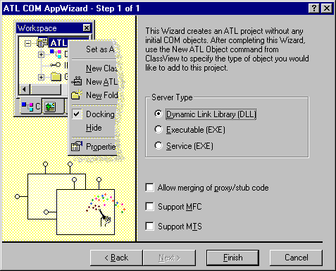
Using the ATL COM AppWizard
In Visual Studio , create new ATL COM APP Wizard project
  Accept defaults (DLL server type, etc.), then click Finish
For the purposes of this exercise, choose DLL server type
For the purposes of this exercise, leave all unchecked
Notes:
Page <number>
WNCOMPG-2 v1.5
Chapter 6, Building a COM Object using ATL

Slide 6
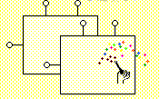

Wizard-Generated Files
SimpleAccount.cpp
Skeleton source file for DLL server. Uses a CComModule object called _Module
SimpleAccount.def
Module definition file that lists functions to be exported from DLL server
SimpleAccount.idl
Skeleton IDL file. Automatically compiled as part of the project.
SimpleAccount.rc
Resource script. Already includes reference to type library
StdAfx.cpp
Source file that includes StdAfx.h, etc. and is used to build pre-compiled header file StdAfx.pch
Resource.h
Defines resource IDs used by SimpleAccount.rc
StdAfx.h
Precompiled header file. Also defines threading model
Notes:
Page <number>
WNCOMPG-2 v1.5
Chapter 6, Building a COM Object using ATL

Slide 7
DLL Source File
Declares a global CComModule object called _Module
  Implements majority of COM server functionality
// SimpleAccount.cpp : Implementation of DLL Exports
#include "stdafx.h"
#include "resource.h"
#include <initguid.h>
#include "SimpleAccount.h"
#include "SimpleAccount_i.c"
CComModule _Module;
BEGIN_OBJECT_MAP(ObjectMap)
END_OBJECT_MAP()
...
// continued
System header file. Allows use of DEFINE_GUID() macro
Generated by MIDL compiler from SimpleAccount.idl
Implements basic functionality of a COM server
Empty object map. This will list component classes that are implemented by this server
= machine-generated file
Notes:
Page <number>
WNCOMPG-2 v1.5
Chapter 6, Building a COM Object using ATL

Slide 8
DLL Initialisation and Termination
CComModule is initialised with object map, etc
// SimpleAccount.cpp (continued)
...
// DLL Entry Point
extern "C"
BOOL WINAPI DllMain(HINSTANCE hInstance, DWORD dwReason,
LPVOID /*lpReserved*/) {
if (dwReason == DLL_PROCESS_ATTACH)
{
_Module.Init(ObjectMap, hInstance, &LIBID_SIMPLEACCOUNTLib);
DisableThreadLibraryCalls(hInstance);
}
else if (dwReason == DLL_PROCESS_DETACH)
_Module.Term();
return TRUE; // ok
}
...
//continued
Notes:
Page <number>
WNCOMPG-2 v1.5
Chapter 6, Building a COM Object using ATL

Slide 9
DLL Exported Functions
All implementation delegated to CComModule
// SimpleAccount.cpp (continued)
...
STDAPI DllCanUnloadNow(void) {
return (_Module.GetLockCount()==0) ? S_OK : S_FALSE;
}
STDAPI DllGetClassObject(REFCLSID rclsid, REFIID riid, LPVOID* ppv) {
return _Module.GetClassObject(rclsid, riid, ppv);
}
STDAPI DllRegisterServer(void) {
// registers object, typelib and all interfaces in typelib
return _Module.RegisterServer(TRUE);
}
STDAPI DllUnregisterServer(void) {
return _Module.UnregisterServer(TRUE);
}
Notes:
Page <number>
WNCOMPG-2 v1.5
Chapter 6, Building a COM Object using ATL

Slide 10
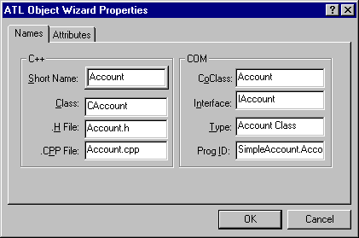
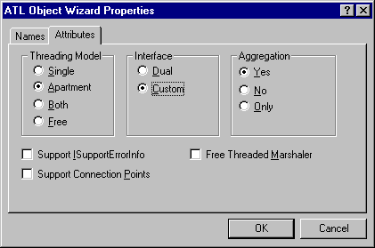
Using the ATL Object Wizard
After selecting Simple Object and clicking Next ...
Enter Short Name of Object, which serves as root for all other names. Can change these if necessary
For the purposes of this exercise, choose Custom interface. Otherwise, accept defaults
Notes:
Page <number>
WNCOMPG-2 v1.5
Chapter 6, Building a COM Object using ATL

Slide 11
Generated Component-Class
Account.h
// Account.h : Declaration of the CAccount
#include "resource.h"
// CAccount
class ATL_NO_VTABLE CAccount :
public CComObjectRootEx<CComSingleThreadModel>,
public CComCoClass<CAccount, &CLSID_Account>,
public IAccount {
public:
CAccount()
{}
DECLARE_REGISTRY_RESOURCEID(IDR_ACCOUNT)
BEGIN_COM_MAP(CAccount)
COM_INTERFACE_ENTRY(IAccount)
END_COM_MAP()
// IAccount
public:
};
Compiler optimisation to suppress creation of a vtable
Templated classes
Our custom interface
Provides resource ID for registry script
COM interface map for this object
Notes:
Page <number>
WNCOMPG-2 v1.5
Chapter 6, Building a COM Object using ATL

Slide 12
Generated Registry-Script
For ATL Registrar to register coclass and type library
Account.rgs
HKCR {
SimpleAccount.Account.1 = s 'Account Class' {
CLSID = s '{B7713F0E-F3DA-11D2-9C70-000000000000}'
}
SimpleAccount.Account = s 'Account Class' {
CLSID = s '{B7713F0E-F3DA-11D2-9C70-000000000000}'
CurVer = s 'SimpleAccount.Account.1'
}
NoRemove CLSID {
ForceRemove {B7713F0E-F3DA-11D2-9C70-000000000000} =
s 'Account Class' {
ProgID = s 'SimpleAccount.Account.1'
VersionIndependentProgID = s 'SimpleAccount.Account'
InprocServer32 = s '%MODULE%' {
val ThreadingModel = s 'Apartment'
}
'TypeLib' = s '{B7713F00-F3DA-11D2-9C70-000000000000}'
}
}
}
Notes:
Page <number>
WNCOMPG-2 v1.5
Chapter 6, Building a COM Object using ATL

Slide 13
Additions to IDL and DLL Source
Entry for IAccount interface
[
object,
uuid(B7713F0D-F3DA-11D2-9C70-000000000000),
helpstring("IAccount Interface"),
pointer_default(unique)
]
interface IAccount : IUnknown
{
};
Entry for Account object
library SIMPLEACCOUNTLib
{
[
uuid(B7713F0E-F3DA-11D2-9C70-000000000000),
helpstring("Account Class")
]
coclass Account
{
[default] interface IAccount;
};
};
#include "Account.h"
BEGIN_OBJECT_MAP(ObjectMap)
OBJECT_ENTRY(CLSID_Account, CAccount)
END_OBJECT_MAP()
Account object now appears in Object Map
Notes:
Page <number>
WNCOMPG-2 v1.5
Chapter 6, Building a COM Object using ATL

Slide 14
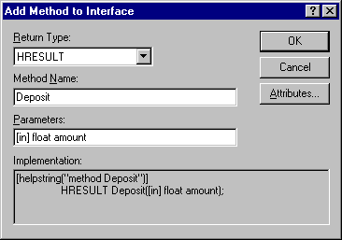
Adding Methods
  Right-click on IAccount in ClassView, then select Add Method ...
Clicking here automatically updates IDL file, C++ header and C++ source
Click here to edit helpstring
Enter parameter list using IDL types and attributes
Complete IDL implementation
// CAccount
STDMETHODIMP CAccount::Deposit(float amount) {
// TODO: Add your implementation code here
return S_OK;
}
Notes:
Page <number>
WNCOMPG-2 v1.5
Chapter 6, Building a COM Object using ATL

Slide 15
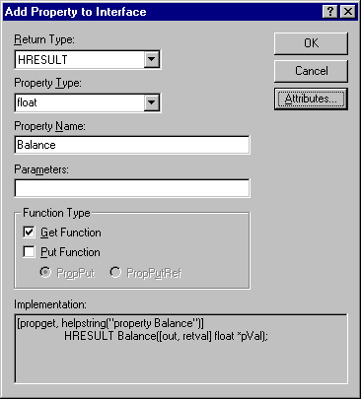
Adding Properties
  Right-click on IAccount in ClassView, then select Add Property ...
Clicking here automatically updates IDL file, C++ header and C++ source
Deselect Put Function for read-only property
// CAccount
STDMETHODIMP CAccount::get_Balance(float *pVal) {
// TODO: Add your implementation code here
return S_OK;
}
Notes:
Page <number>
WNCOMPG-2 v1.5
Chapter 6, Building a COM Object using ATL

Slide 16
Changes to IDL File
IDL file is updated automatically
[
object,
uuid(B7713F0D-F3DA-11D2-9C70-000000000000),
helpstring("IAccount Interface"),
pointer_default(unique)
]
interface IAccount : IUnknown
{
[helpstring("method Deposit")]
HRESULT Deposit([in] float amount);
[helpstring("method Withdraw")]
HRESULT Withdraw([in] float amount);
[propget, helpstring("property Balance")]
HRESULT Balance([out, retval] float *pVal);
};
Notes:
Page <number>
WNCOMPG-2 v1.5
Chapter 6, Building a COM Object using ATL

Slide 17
Implementing Methods and Properties
Now, we must implement the business logic
Account.h
// CAccount
class ATL_NO_VTABLE CAccount :
public CComObjectRootEx<CComSingleThreadModel>,
public CComCoClass<CAccount, &CLSID_Account>,
public IAccount {
public:
CAccount() : m_balance(0)
{}
...
private:
float m_balance;
...
2. Initialise member variable(s)
1. Add private member variable(s)
// Account.cpp
...
STDMETHODIMP CAccount::get_Balance(float *pVal)
{
// TODO: Add your implementation code here
*pVal = m_balance;
return S_OK;
}
3. Implement method(s)
Notes:
Page <number>
WNCOMPG-2 v1.5
Chapter 6, Building a COM Object using ATL

Slide 18
Adding a New Custom Interface
Update IDL file manually, and modify class header
Don’t forget to add interface to coclass section of IDL
[
object,
uuid(E330D0F0-F40B-11d2-9C70-000000000000),
helpstring("ITrade Interface"),
pointer_default(unique)
]
interface ITrade : IUnknown
{
};
Use GUIDGEN to generate new IID
New interface ITrade
class ATL_NO_VTABLE CAccount :
public CComObjectRootEx<CComSingleThreadModel>,
public CComCoClass<CAccount, &CLSID_Account>,
public IAccount,
public ITrade {
...
BEGIN_COM_MAP(CAccount)
COM_INTERFACE_ENTRY(IAccount)
COM_INTERFACE_ENTRY(ITrade)
END_COM_MAP()
Inherit from ITrade as well as IAccount
Add another entry to COM interface map
Notes:
Page <number>
WNCOMPG-2 v1.5
Chapter 6, Building a COM Object using ATL

Slide 19
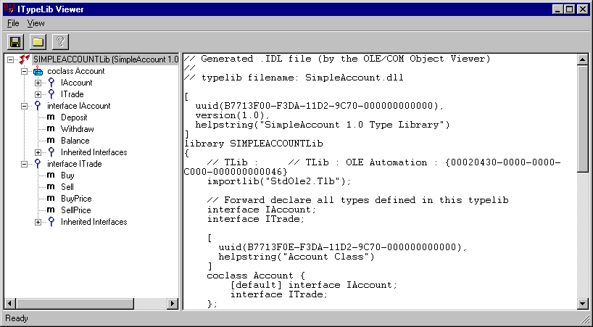
Building and Testing the Server
Build the project
  Automatically registers the server
  Check with OLE/COM Object Viewer
Notes:
Page <number>
WNCOMPG-2 v1.5
Chapter 6, Building a COM Object using ATL

Slide 20
A Closer Look
ATL makes extensive use of template classes and multiple inheritance
Component class is never instantiated directly
  It acts as a base class from which a CComObject<> class is derived
CComObject<> class is a decorator class that implements IUnknown functions
  Actually delegates these functions to CComObjectRootEx<> class
// Account.h : Declaration of the CAccount
class ATL_NO_VTABLE CAccount :
public ComObjectRootEx<CComSingleThreadModel>,
public CComCoClass<CAccount, &CLSID_Account>,
public IAccount
{
...
Notes:
Page <number>
WNCOMPG-2 v1.5
Chapter 6, Building a COM Object using ATL

Slide 21
Class Relationships
CComObjectRootBase
CComObjectRootEx<CComSingleThreadModel>
Handles reference
counting based on
specified threading model
CComCoClass<CAccount, &CLSID_Account>
Defines class factory
and aggregation model
<<interface>>
IAccount
Our custom interface
delegates
CAccount
Our component class.
An abstract base class
CComObject<CAccount>
Implements IUnknown
interface. Concrete class
instantiated by class factory
Notes:
Page <number>
WNCOMPG-2 v1.5
Chapter 6, Building a COM Object using ATL

Slide 22
CComObject<> Template Class
One of a number of CComObjectxxx<> classes
  Supports aggregation/locking models without changing coclass
  Implements IUnknown functions (delegated to ComObjectRootEx<>)
template <class Base>
class CComObject : public Base {
public:
typedef Base _BaseClass;
...
STDMETHOD_(ULONG, AddRef)() {return InternalAddRef(); }
STDMETHOD_(ULONG, Release)() {
ULONG l = InternalRelease();
if (l == 0)
delete this;
return l;
}
STDMETHOD(QueryInterface)(REFIID iid, void ** ppvObject)
{ return _InternalQueryInterface(iid, ppvObject); }
...
static HRESULT WINAPI CreateInstance(CComObject<Base>** pp);
};
Notes:
Page <number>
WNCOMPG-2 v1.5
Chapter 6, Building a COM Object using ATL

Slide 23
Summary
Using the ATL wizards, it is very easy to create a simple COM object
  Wizards generate all of the boilerplate code for object and its server
  You can focus on implementing the business logic
Generated code uses two maps
  Object map lists component classes implemented by a server
  COM map lists all the interfaces exposed by a component class
ATL makes extensive use of macros, template classes and multiple inheritance
  See Beginning ATL COM Programming for more information
Notes:
Page <number>
WNCOMPG-2 v1.5
Chapter 6, Building a COM Object using ATL

